Slide 1
Supply Chain Management for Disaster Prevention and Mitigation
PREVENTION & RISK MITIGATION
Yanquiling, R; Santos, M.C; Pineda, J.D; Panaguiton, R; Fallorin, T. M; Agustin, A; Bravo, J.G; Manabat, M.

Slide 2
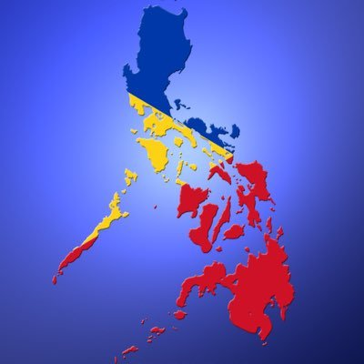
Abstract
Philippines is one of the most disaster-prone countries in the world.
This study will identify prevention measures that can be applied to the entire country.

Slide 3
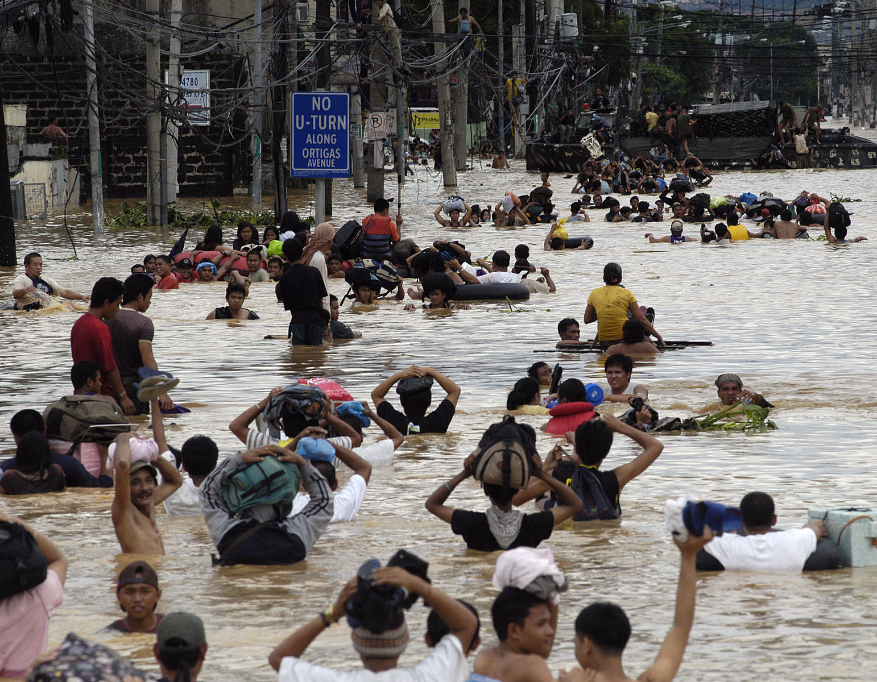
Introduction
A disaster is a sudden, calamitous event that seriously disrupts the functioning of a (International Federation of Red Cross (IFRC), 2016)
4.4 billion people have been affected by disasters since 1994, which claimed 1.3 million lives and cost US$2 trillion in economic losses. (Child Fund International , 2013)

Slide 4
High Risk Areas in the Philippines
Regions | Provinces
I | Ilocos Sur, Ilocos Norte, Pangasinan, La Union, Tarlac
II | Cagayan
III | Pampanga, Nueva Ecija,
V | Albay, Sorsogon, Camarines Norte, Camarines Sur
VI | Masbate, Western Samar, Northern Samar, Catanduanes
CAR | Kalinga, Mountain Province, Apayao, Ifugao,

Slide 5
Philippine Historical Data
Decade | Total No. of Typhoons | Trop. Depression | Trop. Storm | Typhoon | Total Death Toll | Total Amount of Damage (in Billion pesos)
1990-2000 | 185 | 32 | 60 | 93 | 9,537 | 84.82
2001-2010 | 202 | 44 | 62 | 96 | 5,021 | 33.23
Total | 387 | 76 | 112 | 189 | 14,558 | 118.05

Slide 6
Comparing Yolanda vs. Lawin
 | Yolanda (NDRRMC, 2014) | Lawin (NDRRMC, 2016)
1st Landfall | 08 November 2013 4:40AM at Guiuan, Eastern Samar | 19 October 2016 11:00PM at Peñablanca, Cagayan
Public Storm Warning Signal | 4 | 5
Strength | 235kph | 225kph
Gustiness | 275kph | 315kph
Diameter | 400km | 800km
Eye | 14km | 30km
Affected Regions | 9 (IV-A, IV-B, V, VI, VII, VIII, X, XI, Caraga) | 6 (I, II, III, IV-A, V, CAR)
Affected Provinces | 44 | 26
Affected Cities/ Municipalities | 253 | 315
Affected Barangays | 12,139 | 2,782
Affected Families | 3,424,593 | 10,397
Evacuated Families | 7 Principles of SCM 161,973 families | 31,751
Death toll | 6,300 | 14
Injured | 28,688 | 4
Missing | 1,062 | 0
Total houses damaged | 1,140,332 | 90,035
Cost of damages | P95,483,133,070.67 | P3,737,721,352.16

Slide 7
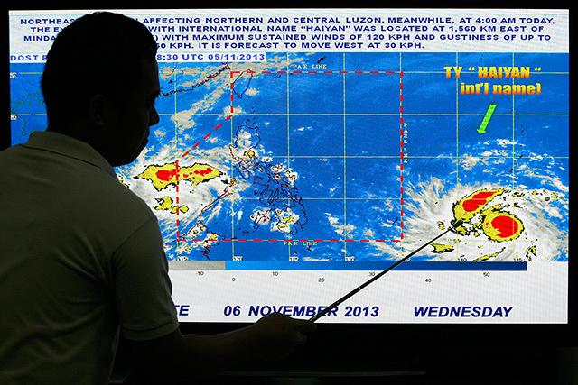
Lessons Learned
What we did right? Government managed to forecast the tract and strength of Typhoon Yolanda, through PAGASA-DOST.
What we did wrong? There is lack of clarity on who was in charge to manage disaster from the national government.

Slide 8
Methodology
Data Gathering
Categorization
Analysis

Slide 9
Application of 7 Principles of Supply Chain Management in Disaster Management
Segment customers based on service needs.
Listen to signals of market demand and plan accordingly.
Develop a supply-chain-wide technology strategy.
Adopt channel-spanning performance measures.

Slide 10
Customer Relation Management in Managing Disaster
Review of Strategy
Customer Segmentation
Customer Service Management
Identify Criteria for Customers Segmentation
Product Management
Identify Gaps
Demand Management
Develop Framework for Disaster Preparedness
Identify Opportunities for Improvement
(Policies and Programs)

Slide 11

Customer Relation Management in Managing Disaster
NDRRMC
Department of Social Welfare and Development (DSWD)
Department of Agriculture (DA)
Department of Agrarian Reform (DAR)
Department of Public Works and Highways (DPWH)
Department of Environment and Natural Resources (DENR)
Climate Change Commission (CCC)
Department of Science and Technology (DOST), as lead agency.

Slide 12
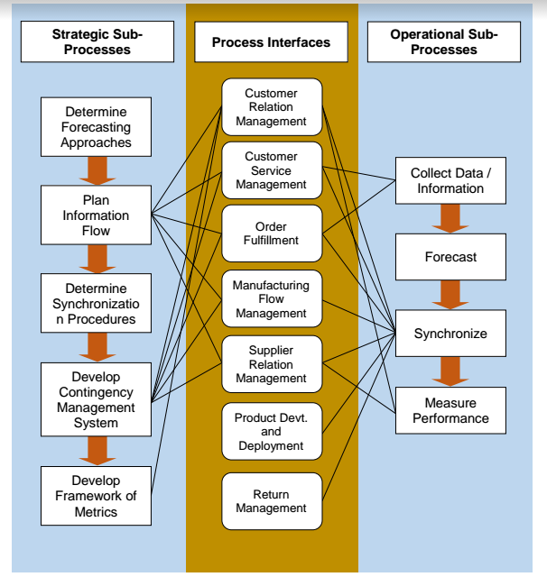
Demand Management in Managing Disasters

Slide 13
NDRRMC Functional Structure

Slide 14
Thematic Areas in Disaster Management

Slide 15
Thematic Area 1: Disaster Prevention and Mitigation

Slide 16
Recommendations
Build capability of local community to respond to any calamity.
Building Capability through Competition Program
Strengthen partnerships and alliances to respond to disaster.
DICT– to study the possibility of having a Mobile Internet and Communication to be used during disaster.
Information System
Large Scale System: Smart City
Department of Energy (DOE) – to study the possibility of manufacturing Portable Solar Kit
Department of Environment and Natural Resources (DENR) – for tracing the spring water and water basins underground

Slide 17
Recommendations
DOH in coordination with the DA – to determine the different variety of medicinal plants as alternative medicine to be planted near the evacuation center.
DA – to provide reference on which root crop to plant
OCD – lead in conducting drill on rescue and relief operations
DSWD– lead in taking care of people in the evacuation center
DOH in coordination with the Philippine Red Cross – lead in conducting drill on responding emergency situations
DepEd - to conceptualize the promotion of hazard/disaster awareness based from the existing Disaster Risk Reduction Resource Manual
(NHA) in partnership with the CREBA- for the construction of typhoon-resistant or earthquake-resistant houses and other structures

Slide 18
Recommendations
Establish protocol to identify and settle dead after disaster
Establish hazard category and equivalent color for the level of governance
Develop single system for disaster preparedness, response, rehabilitation and recovery

Slide 19


Conclusion
Unity and cooperation between government and the general public is important.
Government plays a vital role in disaster prevention and mitigation.
Resources should efficiently and effectively utilize.
New technologies should also be identified out of these resources to minimize the impact of the disaster.

Slide 20
Supply Chain Management for Disaster Prevention and Mitigation
PREVENTION & RISK MITIGATION
Yanquiling, R; Santos, M.C; Pineda, J.D; Panaguiton, R; Fallorin, T. M; Agustin, A; Bravo, J.G; Manabat, M.

